Slide 1
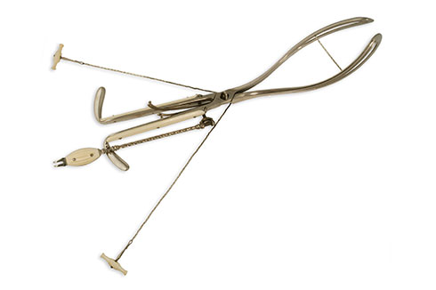
Abortion Instrument

